Slide 1
GYM MANAGEMENT SYSTEM
Developing for
PATILS’S GYM Dharwad

Slide 2
Objectives
The Objective of the “GYM Management System” is to provide a system which handles the information of the people coming into gym and maintaining their health care. It takes care of all their health information. It even maintains the data of what and all the details of the equipment used by the people who join the gym.
Data will be stored in the database. It also maintains the customer details, trainer attendance, gym records. The admin is able to view all the members of the fitness centre as well as their details.

Slide 3
Objectives
The system will perform the task like adding the new member to the gym, removing the member and keeping the payment records
The system which helps the administration in speeding up the tasks at the same time reducing complexity.

Slide 4
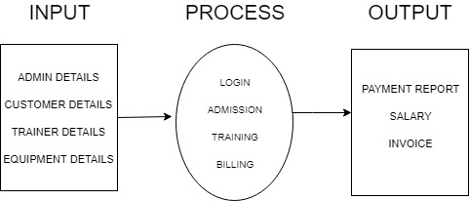
PROCESS LOGIC

Slide 5
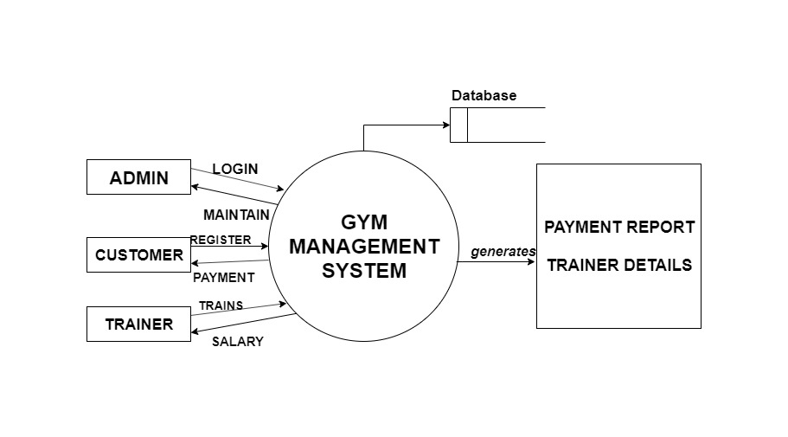
DATA FLOW DIAGRAM
(Zero Level)

Slide 6
Existing System
Existing system was manual.
Time consuming as data entry which include calculations took lot of time.
Searching was very complex as there could be 100’s of entry every year.
This Manually Managed system of the store was also heavily proned to data loss due to certain causes Misplacement of Registers, Destruction of Registers ,Unauthorized access to registers etc. which can bring in disastrous Consequences.
The cost of maintains of data and records of occurrence of transactions is very high.

Slide 7
Proposed System
The Admin has the full-fledged rights over this system.
The admin can register and view the customer profile data.
The admin can make an enouncement about anything.
Admin can mark attendance of customer.
While making announcement and evaluation by admin an email will be sent to customers automatically by system
Admin will update evaluation report of customer, update diet plan, update exercise schedule.
Customer can view the profile data can update it by using his own account
Customer can view their evaluation report, updated diet plan, updated exercise schedule

Slide 8
Suitable Languages
PHP
Mysql
HTML
CSS

Slide 9
Why we selected this language ?
The Software Can be easily to develop in PHP Laravel
Platform Independent
Easy to Run
With the help of PHP we make application using web applications.
Easy to debug.

Slide 10
Tools and Plat form
Adobe Dream viewer
My-SQL
Web Application using CSS and HTML

Slide 11
MODULES
Admin
Customer
Trainer

Slide 12
How does it work?
ADMINISTRATOR:
This actor describes the administration of the gym and admin are the one who owns the gym. The administration has access to all the information.
They can log in through the home screen then there will be options to see the reports about members, trainers, payments etc. After logging in members and admin’s have different options like admin have privileges to access anyone’s information where members are limited to their relation.
CUSTOMER:
This actor represents the gym members either they are going to register or already registered through the online system. The will have fewer options than the admin’s as they access is limited.

Slide 13
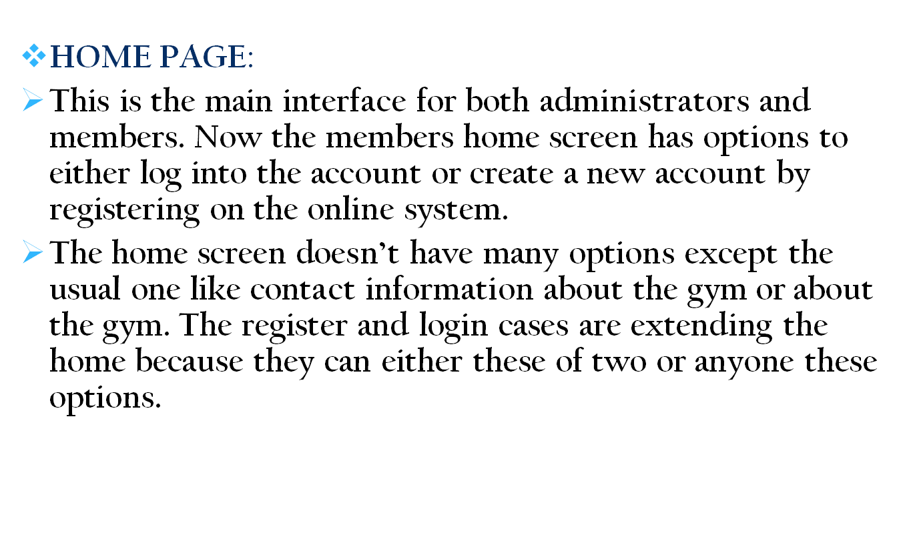
How does it work?

Slide 14
How does it work?
LOGIN:
If the user has registered or already a member of the gym they can open their account by logging in with credentials to have further options on the home screen. The options are extending the login page.
After logging in user/member can view their profile or view the reports they generate in the past reports can be the payment information.
REGISTER:
If there is a new user and wants to become a member they can register through this interface.

Slide 15
How does it work?
PAYMENT:
If the user logged in and select the available package they want to opt. Then they can make payment through the payment interface. For the payment, user/member has two options either go offline or online.
If the user selects online then there will be payment gateway where the user can by using debit, credit card or net banking and after successful payment, the membership will be confirmed.
Where if the user opts for offline then the user has to go to physically to the gym and make payment.
REPORTS:
The report is the stored information which could be for payment, user, trainer etc. The user can generate a report according to their privileges.

Slide 16
How does it work?
TRAINER INFO:
The trainer info is added by the gym owner which is admin and only admin can view that information after logging in with the correct credentials.

Slide 17
Advantages:
Ease of use.
Reduces the staff requirements.
Hassle free finance and fee collection processes.
Saves administration time.
Reliable
Best for communicating with the members and building relationships.

Slide 18
Disadvantages:
Offline reports cannot be generated due to batch mode execution.
The transactions are executed in offline mode, hence online data capture and modification is not possible.

Slide 19

THANK YOU

